Slide 1
Database Systems
Lab 12
Transactions

Slide 2
Transactions
When the application logic needs to execute a sequence of SQL commands in an atomic fashion, then the commands need to be grouped as a logical unit of work (LUW) called SQL transaction
In everyday life, people conduct different kind of business transactions buying products, ordering travels, changing or canceling orders, buying tickets to concerts, paying rents, electricity bills, insurance invoices, etc.
Transactions are recoverable units of data access tasks in terms of database content manipulation

Slide 3
Commit
Any successful execution of the transaction is ended by a COMMIT command

Slide 4
ROLLBACK
unsuccessful execution need to be ended by a ROLLBACK command which automatically recovers from the database all changes made by the transaction

Slide 5
Dirty read
The meaning of this term is as bad as it sounds. You're permitted to read uncommitted, or dirty, data.
You can achieve this effect by just opening an OS file that someone else is writing and reading whatever data happens to be there

Slide 6
Nonrepeatable read
This simply means that if you read a row at time T1 and try to reread that row at time T2, the row may have changed.
It may have disappeared; it may have been updated, and so on

Slide 7
Phantom read
This means that if you execute a query at time T1 and re-execute it at time T2, additional rows may have been added to the database, which may affect your results.
This differs from a nonrepeatable read in that with a phantom read, data you already read hasn't been changed, but instead, more data satisfies your query criteria than before.

Slide 8
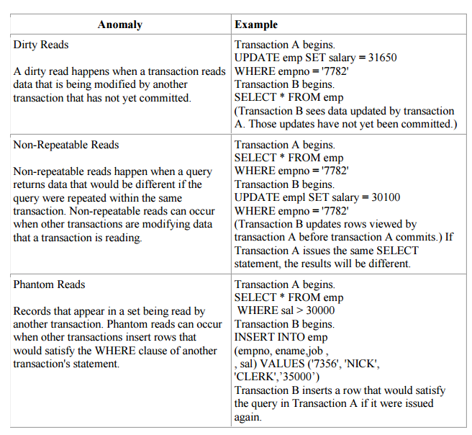

Slide 9
Transaction Isolation Levels
There are four levels of transaction isolation defined in ANSI/ISO SQL standard, with different possible outcomes for the same transaction scenario. That is, the same work performed in the same fashion with the same inputs may result in different answers, depending on your isolation level

Slide 10
Serializable
With a lock-based concurrency control DBMS implementation, serializability requires read and write locks (acquired on selected data) to be released at the end of the transaction

Slide 11
Repeatable reads
In this isolation level, a lock-based concurrency control DBMS implementation keeps read and write locks (acquired on selected data) until the end of the transaction

Slide 12
Read committed
Read committed is an isolation level that guarantees that any data read is committed at the moment it is read

Slide 13
Read uncommitted
This is the lowest isolation level. In this level, dirty reads are allowed, so one transaction may see not-yet-committed changes made by other transactions

Slide 14
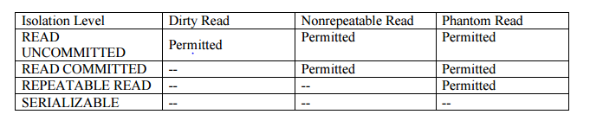

Slide 15
COMMAND TO SET ISOLATION LEVEL:
SET TRANSACTION ISOLATION LEVEL {SERIALIZABLE | READ COMMITTED}; OR SET TRANSACTION READ ONLY

Slide 16
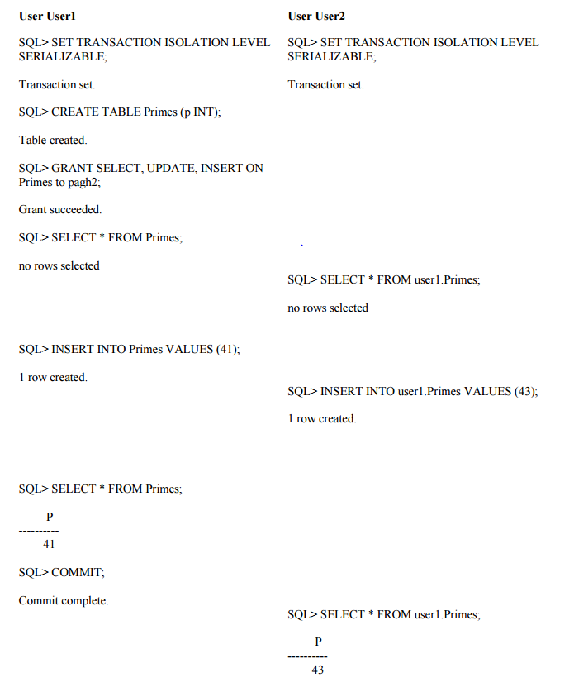

Slide 17
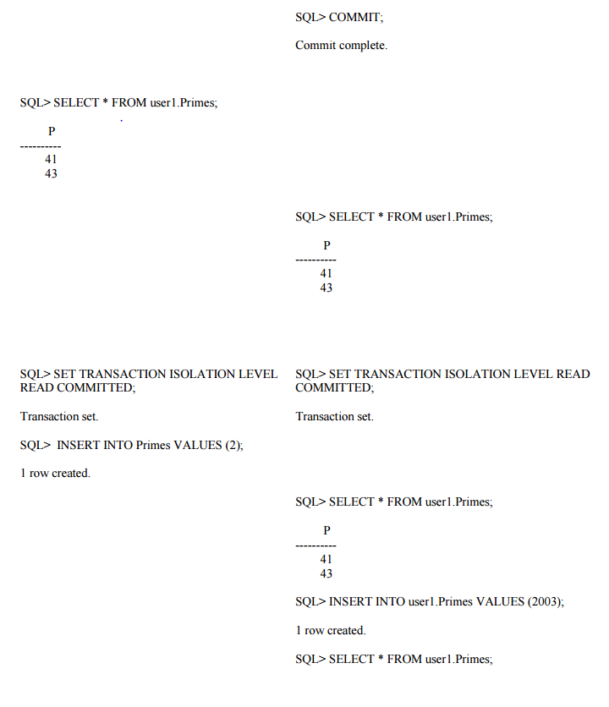

Slide 18
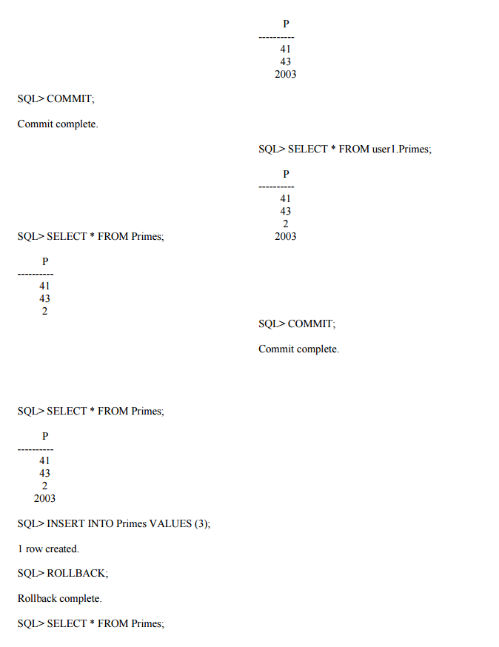

Slide 19
Exercise
ROLLBACK AND COMMIT:
create a table named "T", having two columns: id (of type integer, the primary key), s (of type character string with a length varying from 1 to 40 characters)
Insert 5 rows to the newly created table
Select * from T;
Observe the data in Table.
ROLLBACK
Select * from T;
Observe the data in Table.
SET AUTOCOMMIT ON;
Insert 5 rows again in table.
Transaction Isolation:
STEP 1: Create a table TAB with an attribute tno. STEP 2: Create a table t_log with attribute t_count. STEP 3: Implement a PL/SQL procedure p1 that writes into a table TAB the numbers 1 to 100 (each in a separate tuple). STEP 4: Write a procedure p2 that counts 5 times the number of tuples in it. STEP 5: Inserts each of the counting results into a tuple in a log table. STEP 6: Set isolation transaction mode to read committed with the following command. Set transaction isolation level read committed STEP 7: Execute p1 and p2 concurrently on two pc’s separately, where both transactions are in read committed isolation. STEP 8: Check the content of the log table. How do you justify the obtained result??

